Slide 1


http://www.comp.nus.edu.sg/~cs2100/
Recitation 5
Datapath Design

Slide 2

Source: https://satyambnsal.medium.com/we-are-in-a-dopamine-loop-9a8f784aa1c7

Slide 3


Source: https://healthywithin.com/the-teen-brain-smartphone-social-media-addictions/
Notes:
In today’s world where distractions are everywhere, the ability to focus has become more and more difficult to achieve. We are constantly being stimulated, feeling restless, often without knowing why.
When the time comes to work, we suddenly find an excess of other things to do. Instead of working toward our goals, we go for a walk, grab a coffee, or check our emails. Everything seems like a great idea—everything except the very things we should be doing.

Slide 4

The Hardware Stack
Transistor
Logic Gate
Circuits
Memory
Processor

Slide 5
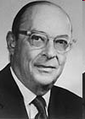
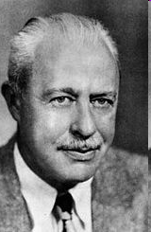
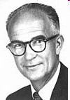
Fundamentals
In the beginning… there was the transistor
John Bardeen
(1908-1991)
William Shockley
(1910-1989)
Walter Houser Brattain
(1902-1987)
Won a second Nobel prize for Physics in 1972!
The 1956 Nobel Prize in Physics
"for their researches on semiconductors and their discovery of the transistor effect"

Slide 6
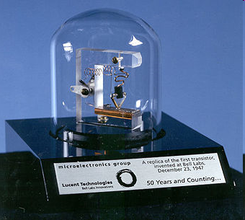
On December 23, 1947…
A single invention was to change the world

Slide 7

So what is a transistor?
It is a solid state switch
The input switches on or off the output
That why computers can only deal with 1’s and 0’s – switch on or off
It is an amplifier
The output signal is much stronger than the input
You can connect things up

Slide 8
The Metallic Oxide Semiconductor Field Effect Transistor
Gate oxide insulator
Gate
-
+
-
N⁺ source
+
N⁺ drain
+
-
-
+
-
+
P⁻ substrate
+
N-Channel Metallic Oxide Semiconductor Field Effect Transistor

Slide 9
ACTION!
++++++
Gate oxide insulator
-
+
Gate
+++++++++++++++
+
- - - - - - - - - - - - - - - - - - -
N⁺ source
-
N⁺ drain
-
-
-
-
-
-
+
+
+
-
+
-
-
P⁻ substrate
N-Channel Metallic Oxide Semiconductor Field Effect Transistor

Slide 10

From switch to gates
Just switching on and off not enough to compute
Need to build Boolean logic gates so as to compute Boolean logic functions
The basic gates:
NOT
OR, AND
NAND, NOR

Slide 11
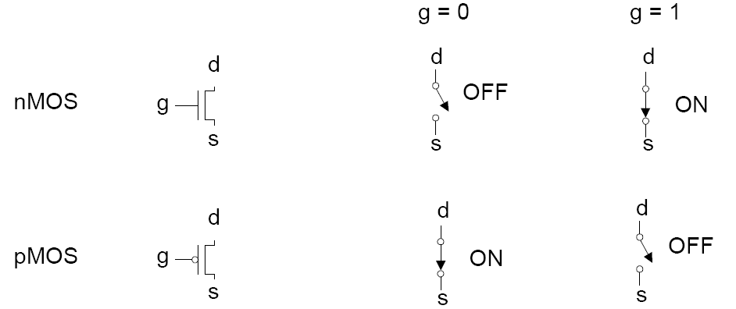
N-channel and P-channel

Slide 12
CMOS NOT Gate
V_{DD}
P-channel MOSFET
Input:
0 = 0V
1 = +5V
Output
CMOS Inverter
N-channel MOSFET
GND

Slide 13
CMOS NOT Gate
V_{DD}
P-channel MOSFET
Input:
1 = +5V
Output = 0
CMOS Inverter
N-channel MOSFET
GND

Slide 14
CMOS NOT Gate
V_{DD}
P-channel MOSFET
Input:
0 = 0V
Output = 1
CMOS Inverter
N-channel MOSFET
GND

Slide 15
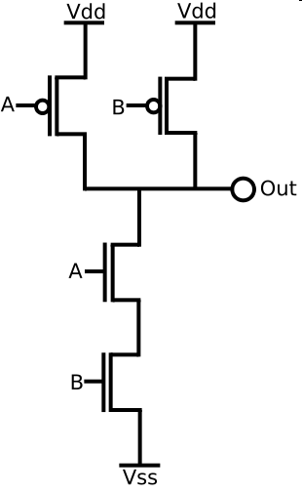
A very important gate: The CMOS NAND gate
A | B | A AND B | A NAND B
0 | 0 | 0 | 1
0 | 1 | 0 | 1
1 | 0 | 0 | 1
1 | 1 | 1 | 0
Can you figure out what is
happening here?
GND

Slide 16
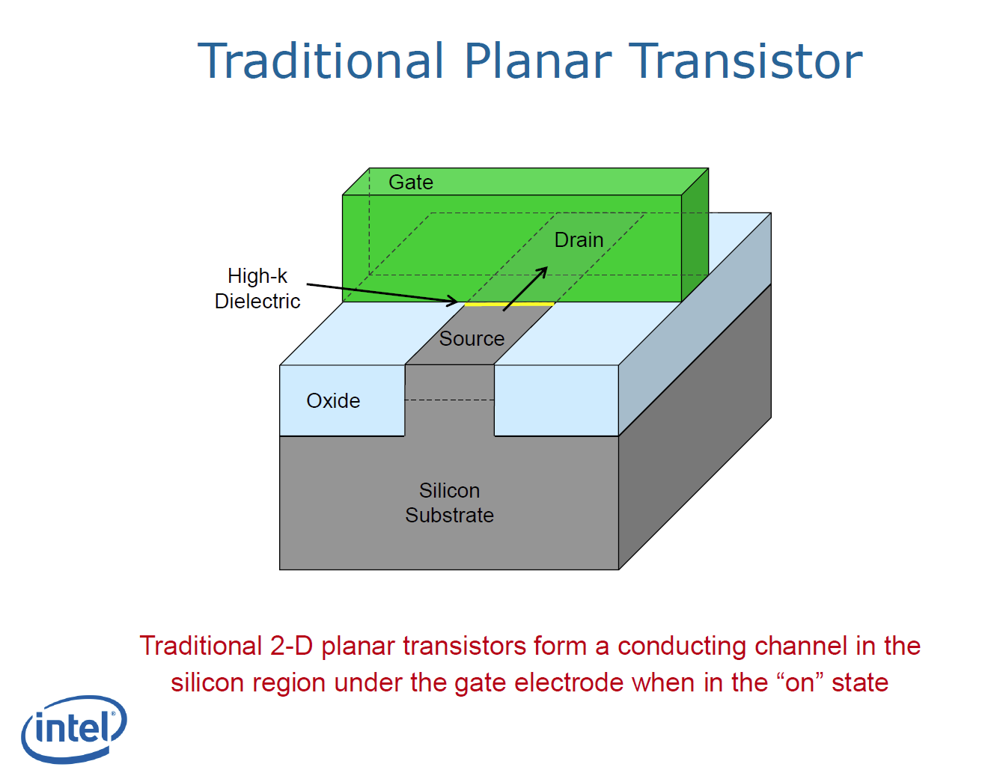
Improvements (1)

Slide 17
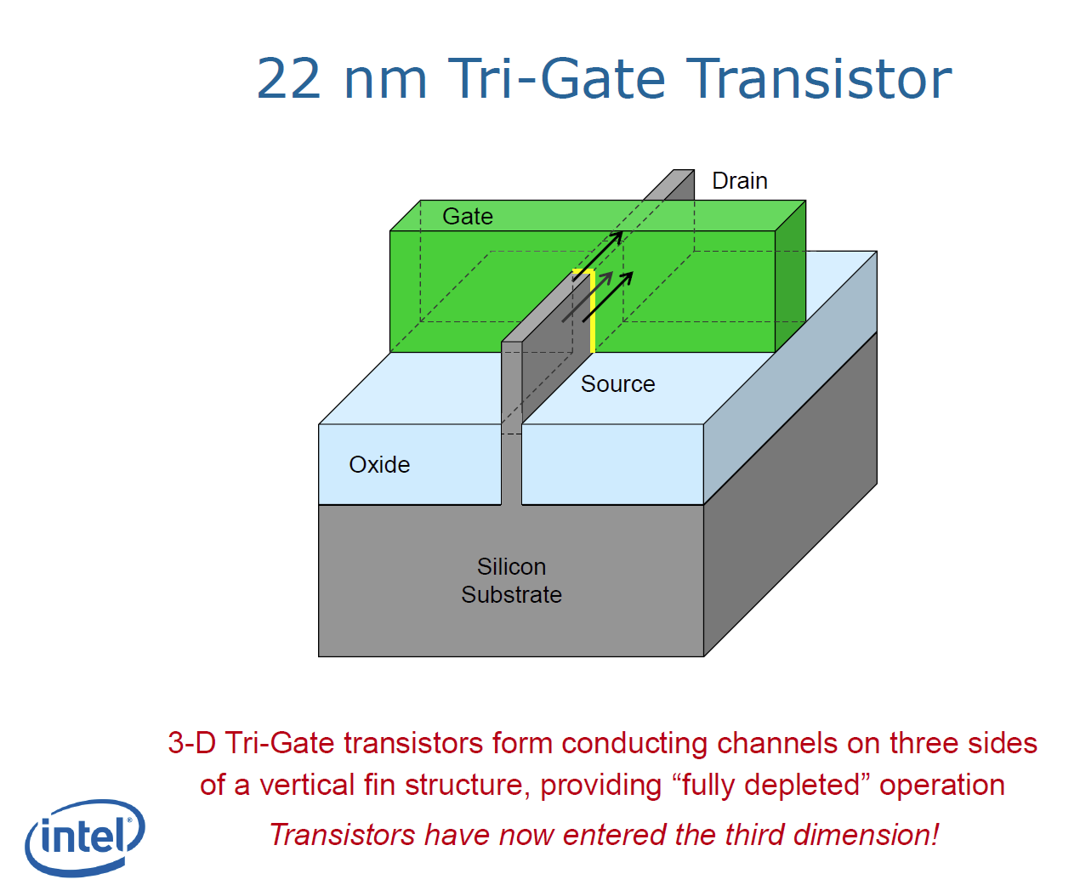
Improvements (2)

Slide 18
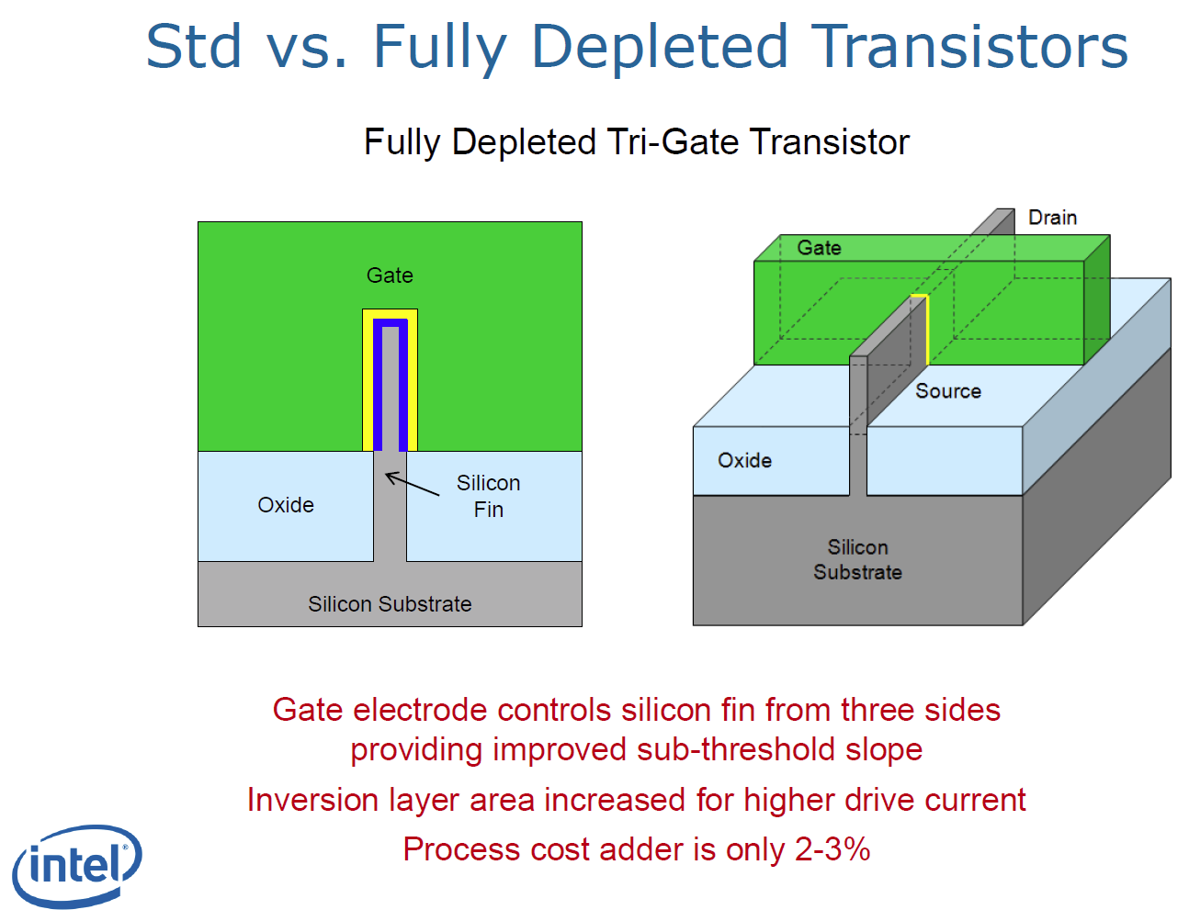
Improvements (3)

Slide 19
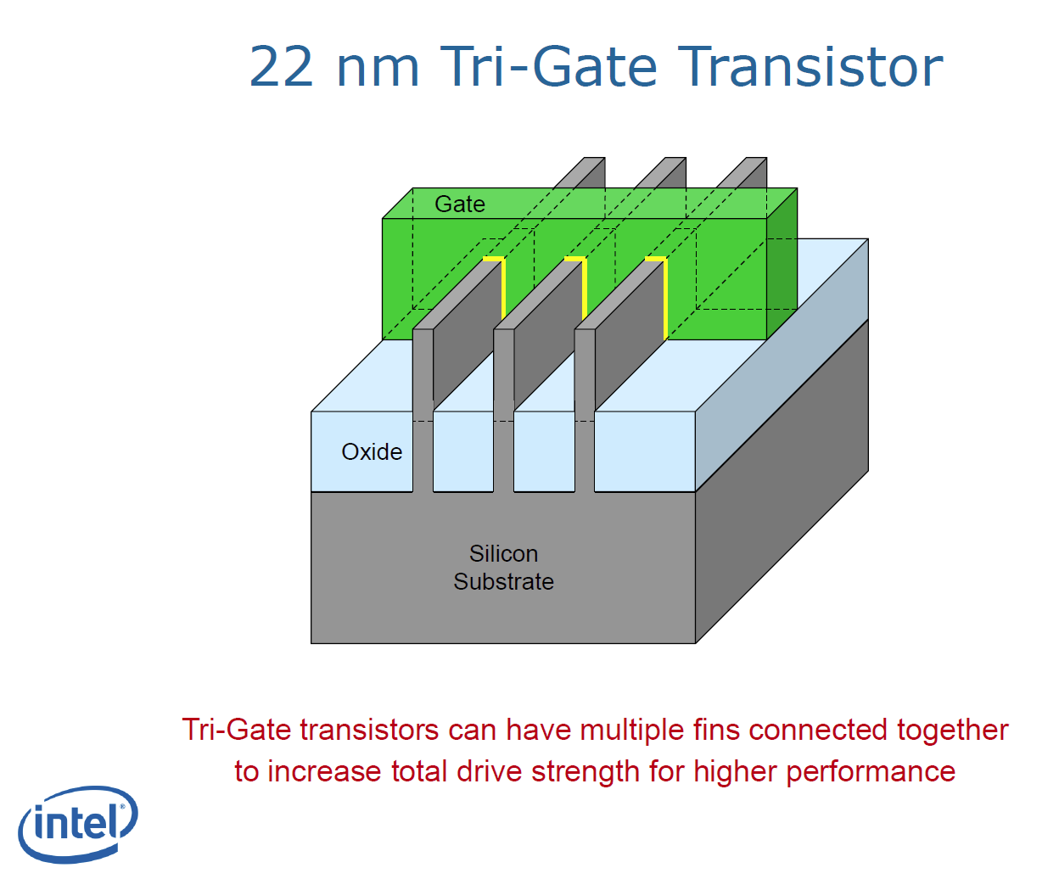
Improvements (4)

Slide 20
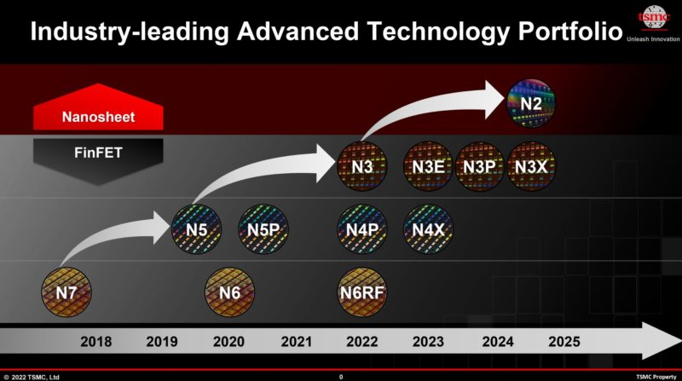
Fun links: 1. https://www.youtube.com/watch?v=p5JQX1BvsDI
2. https://www.youtube.com/watch?v=GdLRSF5wZpE
3. https://www.youtube.com/watch?v=LcOoQP7nhl4

Slide 21
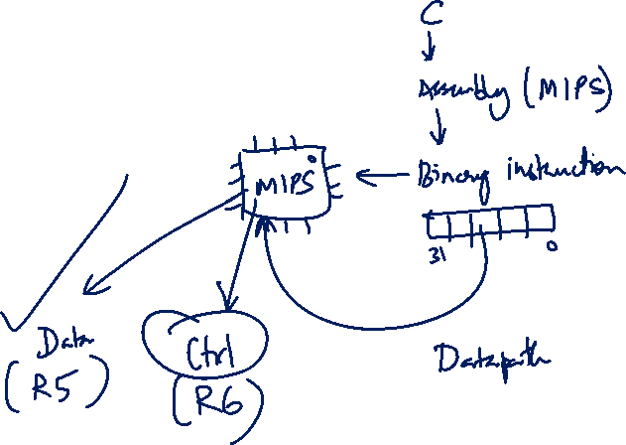
Agenda
Quick Summary
Solutions to Week 5 Quiz
Extra Questions
QnA Questions

Slide 22
summary
The Big Picture: Instruction Cycles

Slide 23
3. Instruction Execution Cycle (Basic)
Fetch:
Get instruction from memory
Address is in Program Counter (PC) Register
Decode:
Find out the operation required
Operand Fetch:
Get operand(s) needed for operation
Execute:
Perform the required operation
Result Write (Store):
Store the result of the operation
Instruction
Fetch
Instruction
Decode
Next Instruction
Operand
Fetch
Execute
Result
Write

Slide 24
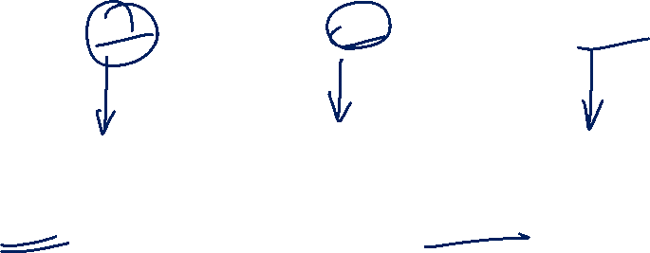
4. MIPS Instruction Execution (2/2)
Design changes:
Merge Decode and Operand Fetch – Decode is simple for MIPS
Split Execute into ALU (Calculation) and Memory Access
 | add $3, $1, $2 | lw $3, 20( $1 ) | beq $1, $2, label
Fetch | Read inst. at [PC] | Read inst. at [PC] | Read inst. at [PC]
Decode & Operand Fetch | Read [$1] as opr1 Read [$2] as opr2 | Read [$1] as opr1 Use 20 as opr2 | Read [$1] as opr1 Read [$2] as opr2
ALU | Result = opr1 + opr2 | MemAddr = opr1 + opr2 | Taken = (opr1 == opr2 )? Target = (PC+4) + ofst×4
Memory Access |  | Use MemAddr to read from memory
Result Write | Result stored in $3 | Memory data stored in $3 | if (Taken) PC = Target
add $3, $1, $2
lw $3, 20($1)
beq $1, $2, ofst

Slide 25
summary
Fetching

Slide 26
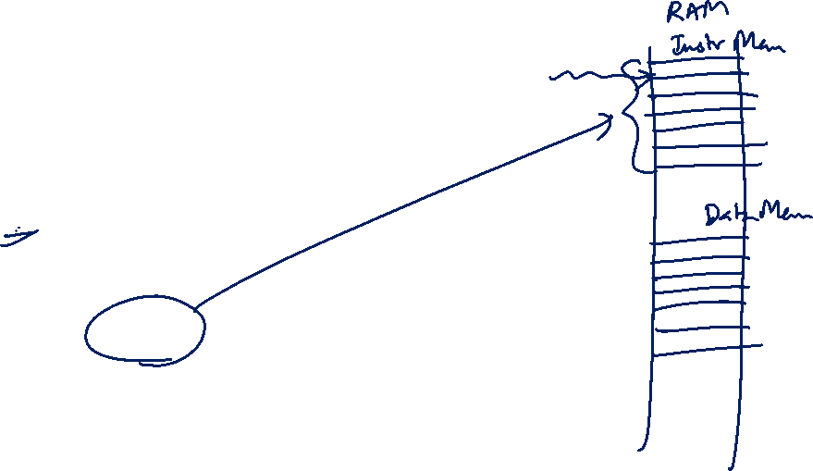
5.1 Fetch Stage: Block Diagram
A simple adder
Add
4
Decode Stage
PC
Read
address
Instruction
Instruction
A register
Instruction
memory
Memory which stores program instructions

Slide 27
summary
Decoding

Slide 28
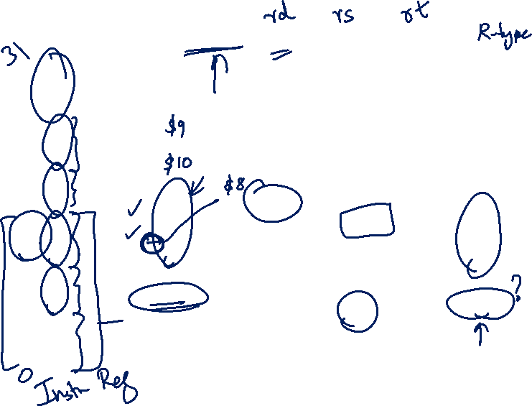
5.2 Decode Stage: Choice in Data 2
add $8, $9, $10
Inst [25:21]
5
Read
register 1
Read
data 1
32
contents of register $9
Inst [20:16]
5
Read
register 2
Register
File
contents of register $10
MUX
5
Write
register
opcode
31:26
rs
25:21
rt
20:16
rd
15:11
shamt
10:6
funct
5:0
32
000000
01001
01010
01000
00000
100000
Read
data 2
MUX
Write
data
Inst [15:11]
RegWrite
RegDst
ALUSrc
Inst [15:0]
16
Sign Extend
32
ALUSrc:
A control signal to choose either "Read data 2" or the sign extended Inst[15:0] as the second operand
Bits 0 to 15 sign extended to 32 bits

Slide 29
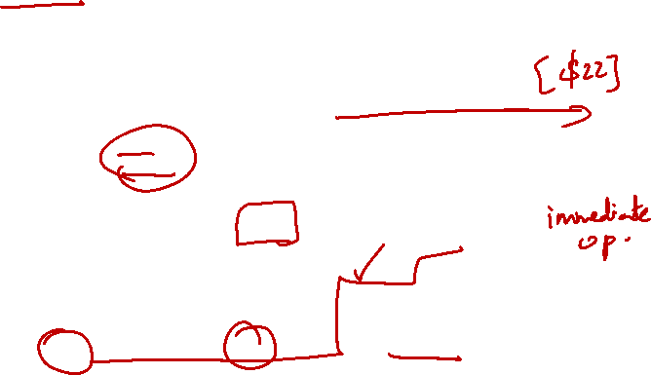
5.2 Decode Stage: Choice in Data 2
addi $21, $22, -50
opcode
31:26
rs
25:21
rt
20:16
Inst [25:21]
5
Read
register 1
Read
data 1
32
contents of register $22
Inst [20:16]
5
Read
register 2
Register
File
content of register $21
001000
10110
10101
MUX
5
Write
register
1111 1111 1100 1110
Read
data 2
32
MUX
Write
data
Inst [15:11]
Immediate
15:0
RegWrite
RegDst
ALUSrc
Inst [15:0]
16
Sign Extend
32
ALUSrc:
A control signal to choose either "Read data 2" or the sign extended Inst[15:0] as the second operand
-50 sign extended to 32 bits

Slide 30
summary
Executing

Slide 31
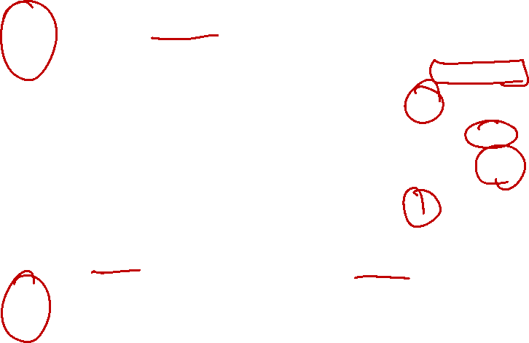
5.3 ALU Stage: Non-Branch Instructions
We can handle non-branch instructions easily:
add $8, $9, $10
contents of register $9
ALUcontrol
Inst [25:21]
5
Read
register 1
Read
data 1
32
4
[$9] + [$10]
Inst [20:16]
5
Read
register 2
isZero?
Register
File
contents of register $10
opcode
31:26
rs
25:21
rt
20:16
rd
15:11
shamt
10:6
funct
5:0
5
Write
register
ALU
ALU
result
32
000000
01001
01010
01000
00000
MUX
100000
Read
data 2
32
MUX
Write
data
Inst [15:11]
RegWrite
RegDst
Sign Extend
ALUSrc
ALUcontrol:
Set using opcode + funct field (more in next lecture)
Inst [15:0]
16
32
Bits 15:0 of IR sign extended to 32 bits

Slide 32
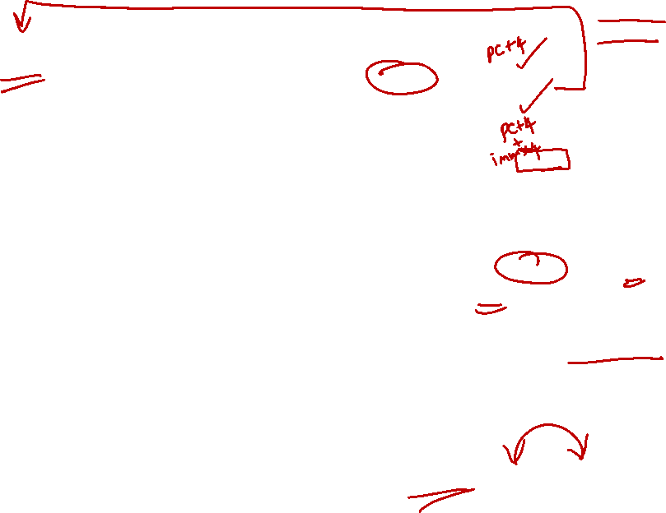
Complete ALU Stage
(PC + 4) + Immed x 4
PC
Add
PC+4
MUX
4
Add
PCSrc:
Control Signal to select between (PC+4) or Branch Target
Left Shift 2-bit
PCSrc
Immed x 4
contents of register $9
ALUcontrol
opcode
31:26
rs
25:21
rt
20:16
Inst [25:21]
5
Read
register 1
Read
data 1
32
4
Inst [20:16]
5
Read
register 2
Register
File
isZero?
contents of register $10
5
Write
register
ALU
ALU
result
32
000100
01001
00000
0000 0000 0000 0011
MUX
Read
data 2
32
MUX
[$9] – [$10]
Write
data
Inst [15:11]
Immediate
15:0
RegWrite
RegDst
Sign Extend
32
ALUSrc
Inst [15:0]
16
Immed
beq $9, $0, 3

Slide 33
summary
Reading/Writing Memory

Slide 34
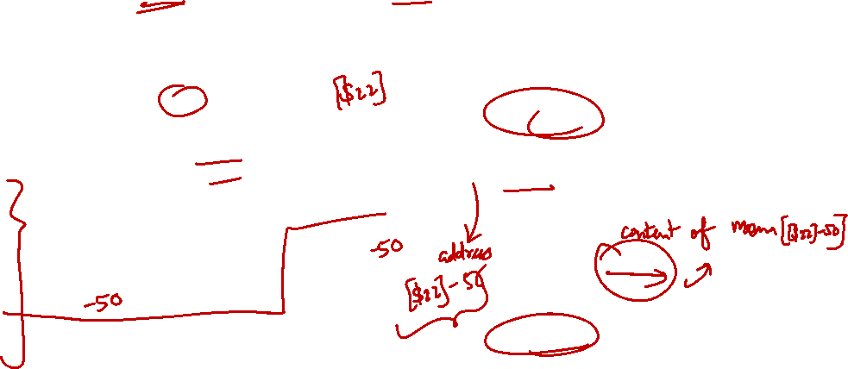
5.4 Memory Stage: Load Instruction
Only relevant parts of Decode and ALU Stages are shown
lw $21, -50($22)
100011
ALUcontrol
opcode
31:26
rs
25:21
rt
20:16
10110
Inst [25:21]
5
4
RR1
RD1
32
Inst [20:16]
5
MemWrite
RR2
10101
Register
File
ALU
5
WR
32
000100
01001
00000
0000 0000 0000 0011
ALU
result
MUX
32
Address
RD2
MUX
WD
Data
Memory
Inst [15:11]
Immediate
15:0
RegWrite
Read
Data
32
1111 1111 1100 1110
Write
Data
RegDst
Sign Extend
ALUSrc
Inst [15:0]
16
32
MemRead

Slide 35
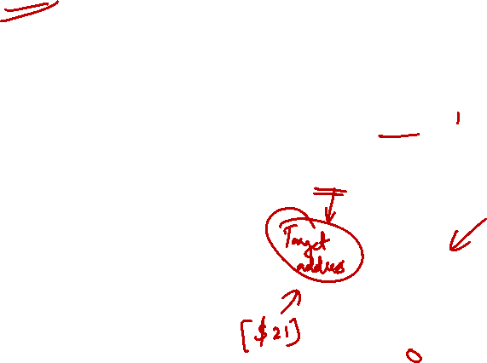
5.4 Memory Stage: Store Instruction
Need Read Data 2 (from Decode stage) as the Write Data
sw $21, -50($22)
ALUcontrol
opcode
31:26
rs
25:21
rt
20:16
Inst [25:21]
5
4
RR1
RD1
32
Inst [20:16]
5
MemWrite
RR2
Register
File
ALU
101011
10110
10101
5
WR
1111 1111 1100 1110
ALU
result
000100
01001
00000
0000 0000 0000 0011
32
MUX
32
Address
RD2
MUX
WD
Data
Memory
Inst [15:11]
Immediate
15:0
RegWrite
Read
Data
32
RegDst
Write
Data
Inst [15:0]
16
Sign Extend
32
MemRead

Slide 36

5.4 Memory Stage: Non-Memory Inst.
Add a multiplexer to choose the result to be stored
add $8, $9, $10
ALUcontrol
Inst [25:21]
5
4
RR1
RD1
32
5
MemWrite
Inst [20:16]
RR2
Register
File
ALU
opcode
31:26
rs
25:21
rt
20:16
rd
15:11
shamt
10:6
5
000000
01001
01010
01000
funct
5:0
WR
ALU
result
00000
MUX
100000
32
Address
RD2
MUX
WD
Data
Memory
Inst [15:11]
Read
Data
RegWrite
MUX
RegDst
Write
Data
Inst [15:0]
16
Sign Extend
32
MemToReg:
A control signal to indicate whether result came from memory or ALU unit
MemToReg

Slide 37
summary
Writing Back

Slide 38
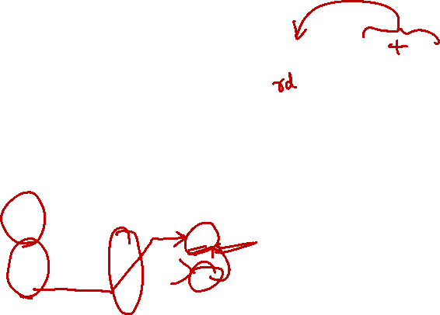
5.5 Register Write Stage: Routing
add $8, $9, $10
opcode
31:26
000000
ALUcontrol
rs
25:21
01001
Inst [25:21]
5
4
RR1
RD1
5
MemWrite
rt
20:16
Inst [20:16]
RR2
01010
Register
File
ALU
MUX
5
WR
ALU
result
MUX
Address
rd
15:11
01000
RD2
Data
Memory
MemToReg
WD
Inst [15:11]
Read
Data
shamt
10:6
00000
RegWrite
MUX
Write
Data
Inst [15:0]
Sign Extend
funct
5:0
100000

Slide 39
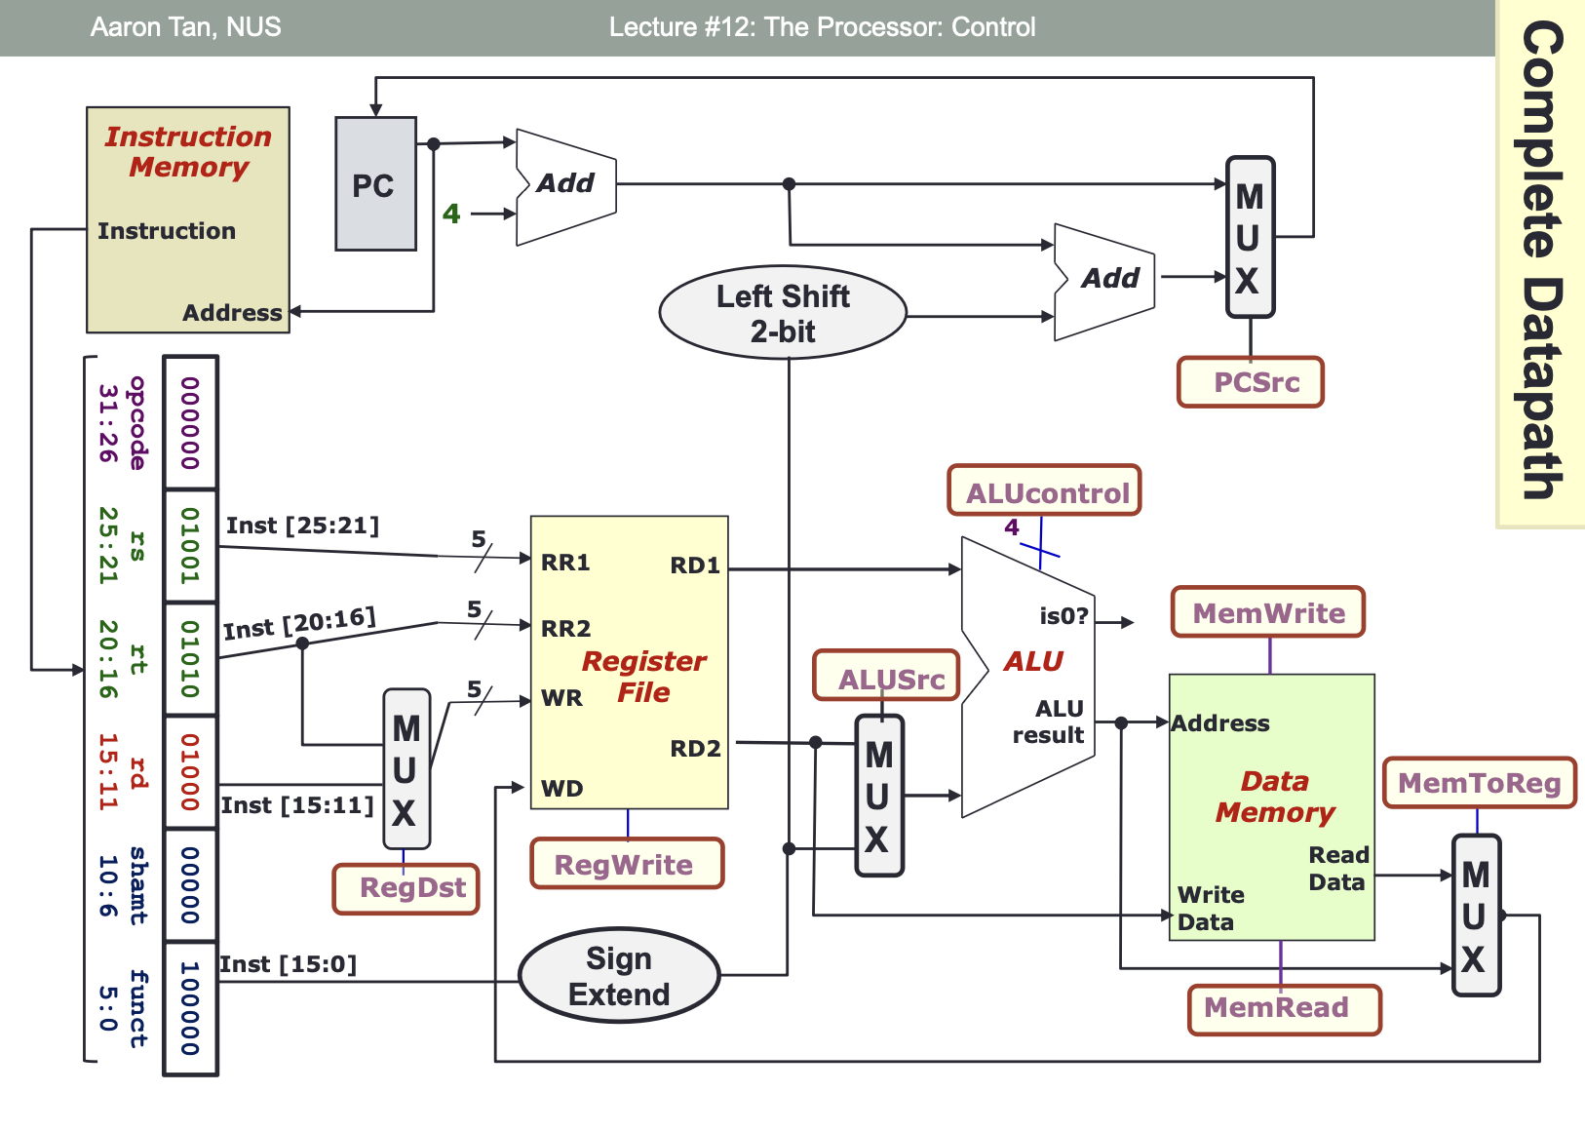
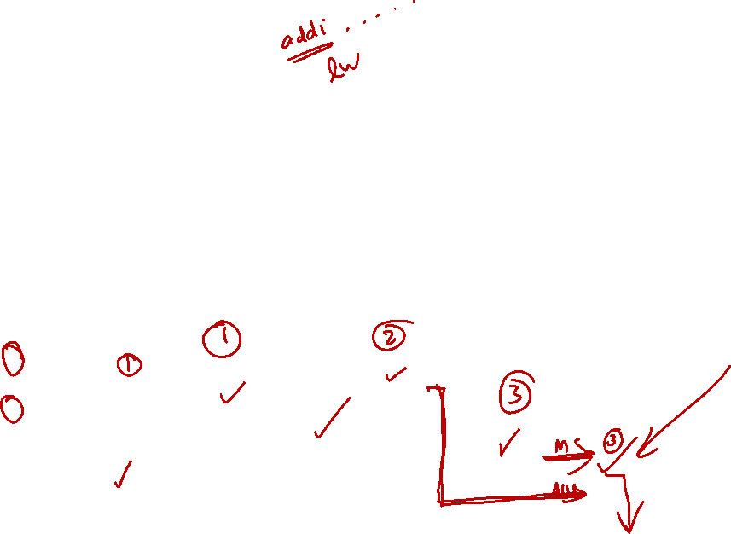
Complete Datapath

Slide 40
Week-5 Quiz

Slide 41
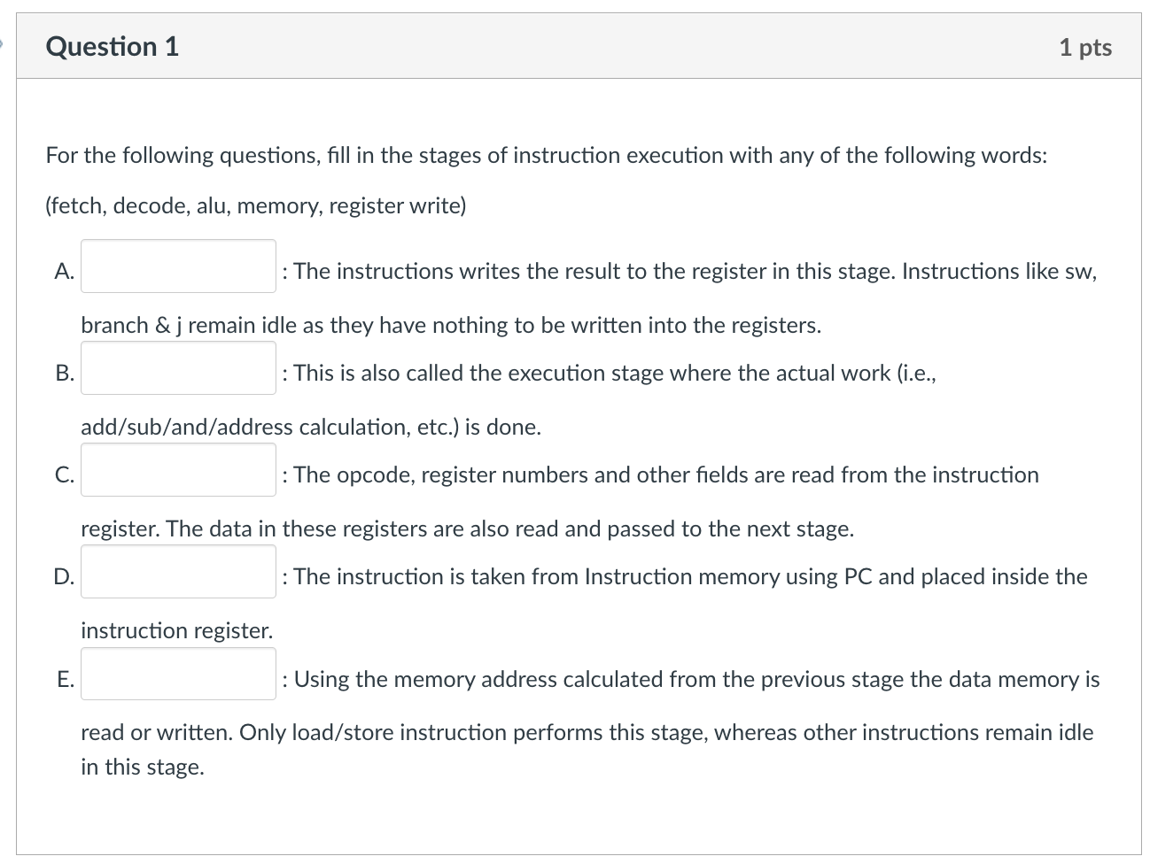
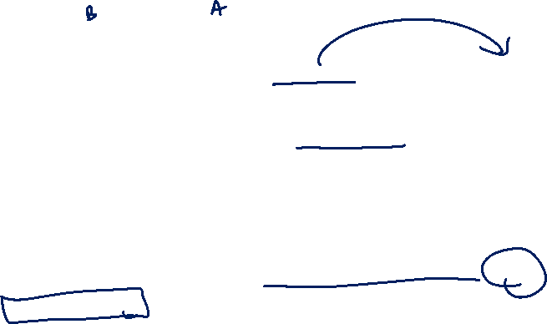
Register write
ALU
Decode
Fetch
Memory

Slide 42
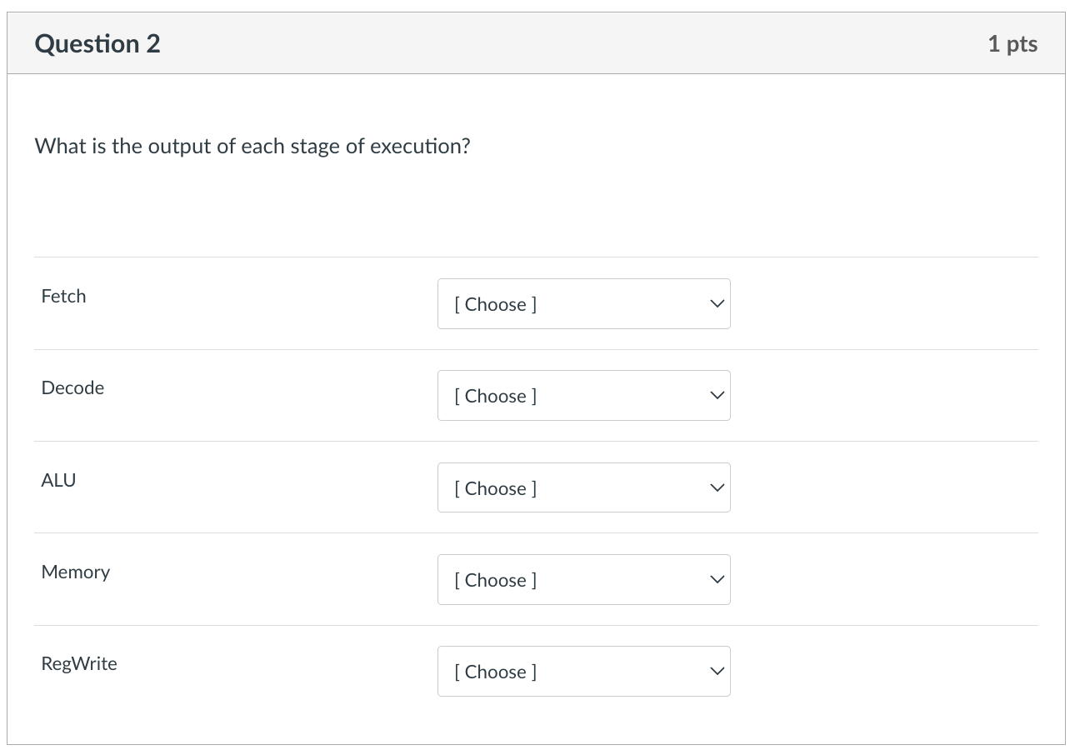
32-bit instruction in binary
Operands 1 and 2 for the ALU
The result computed by the ALU and the 1-bit signal isZero
The data read from memory. For some instructions this stage is not executed.
No output. Only the data from the ALU or memory is written to the Write Register (WR)

Slide 43
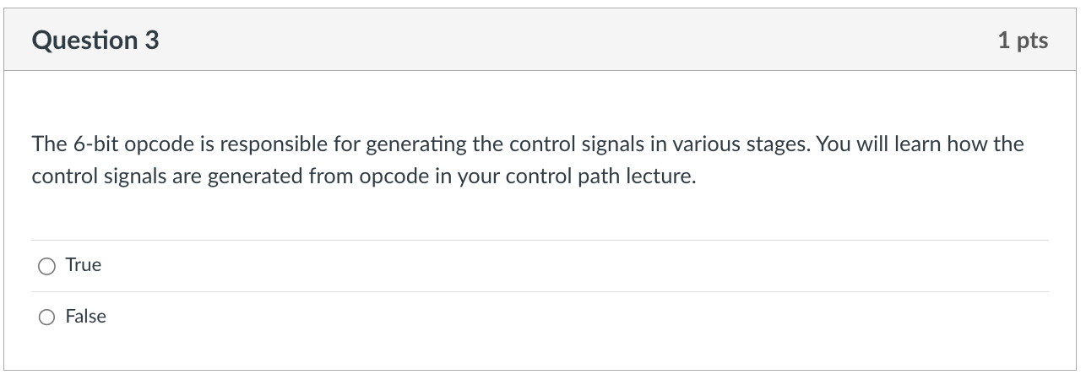

Slide 44
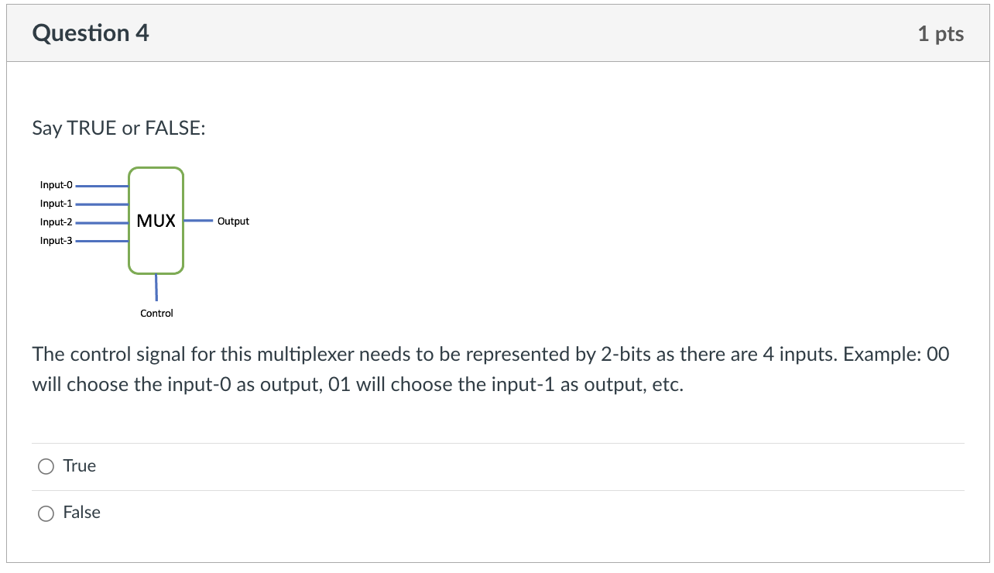
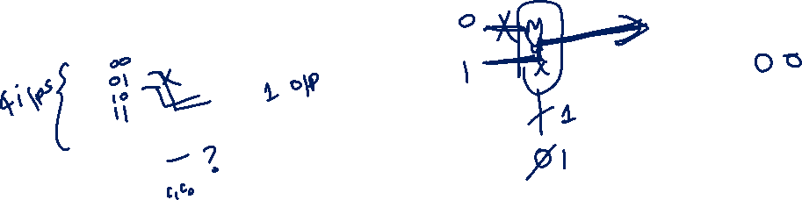

Slide 45
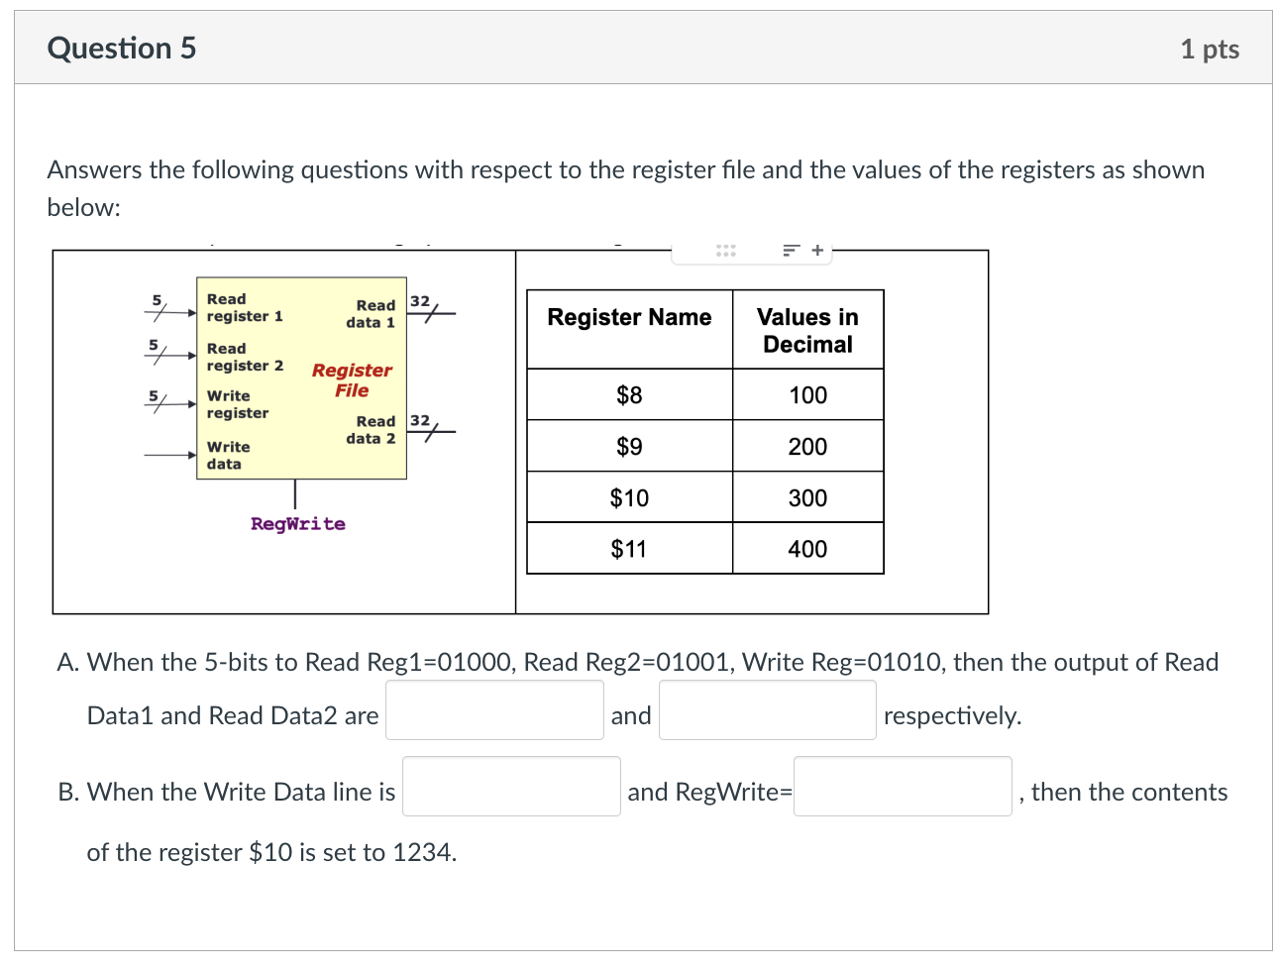
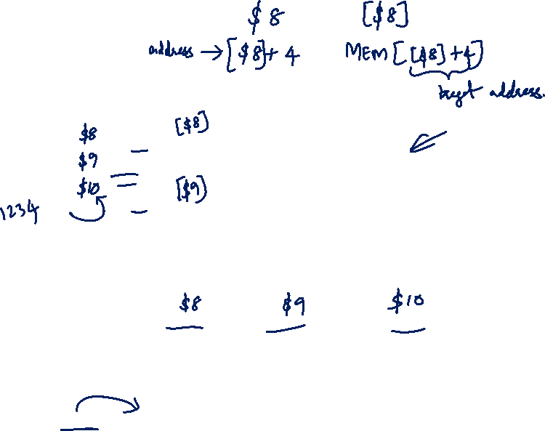
100
200
1234
1

Slide 46
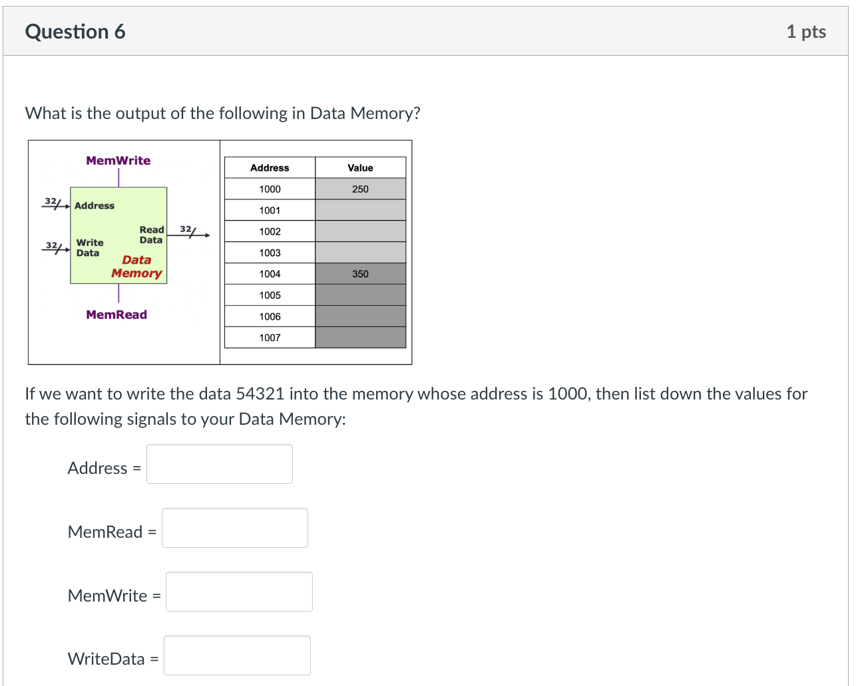
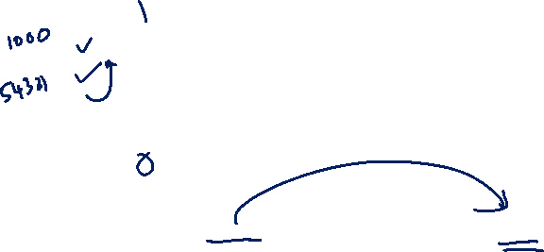
1000
0
1
54321

Slide 47
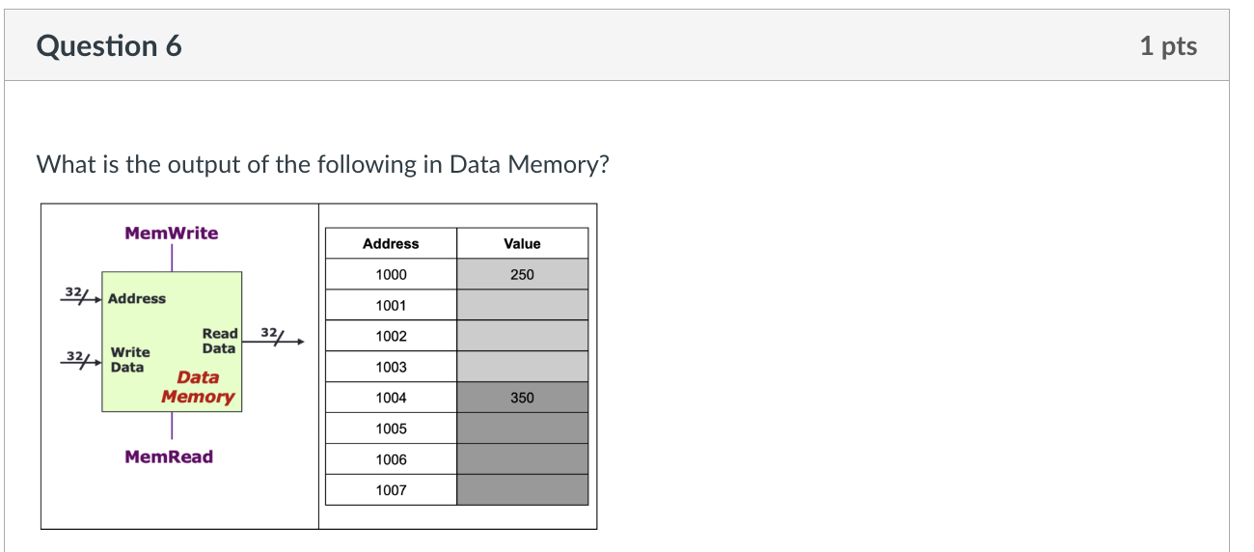
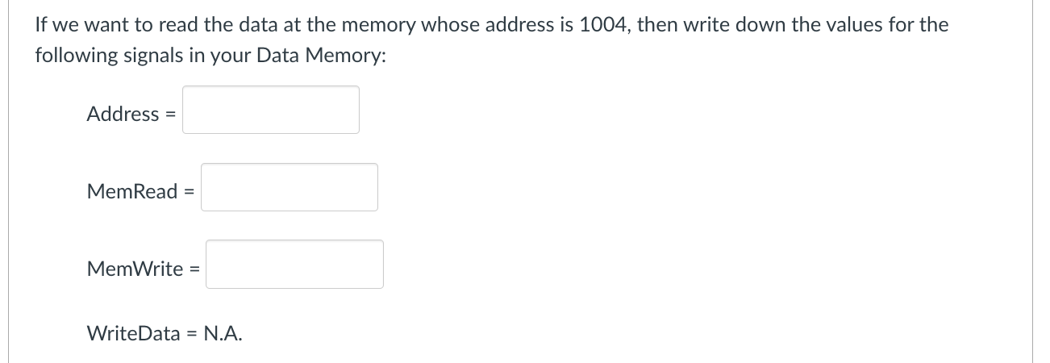
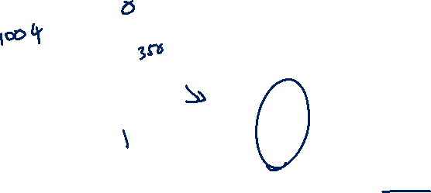
1004
1
0

Slide 48
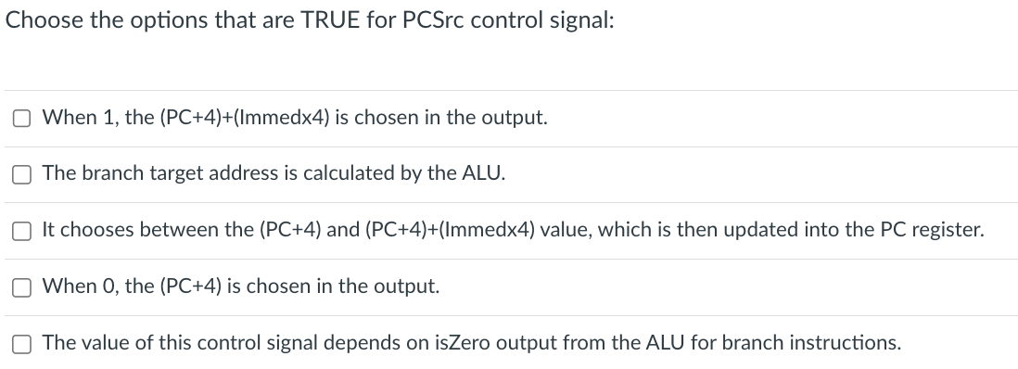
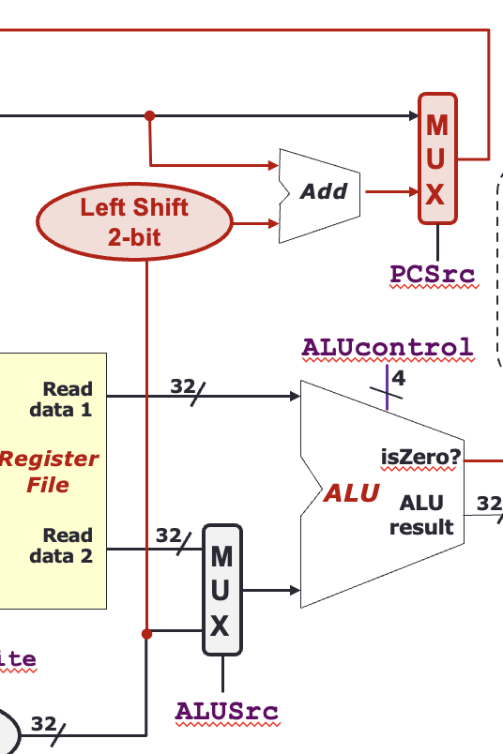


Slide 49
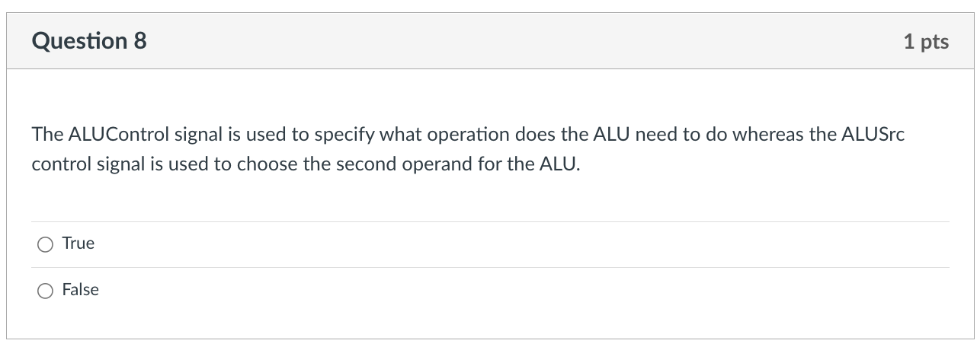


Slide 50
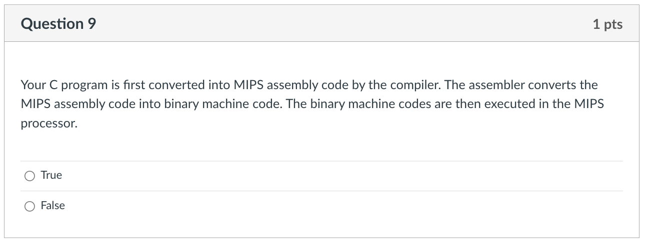


Slide 51
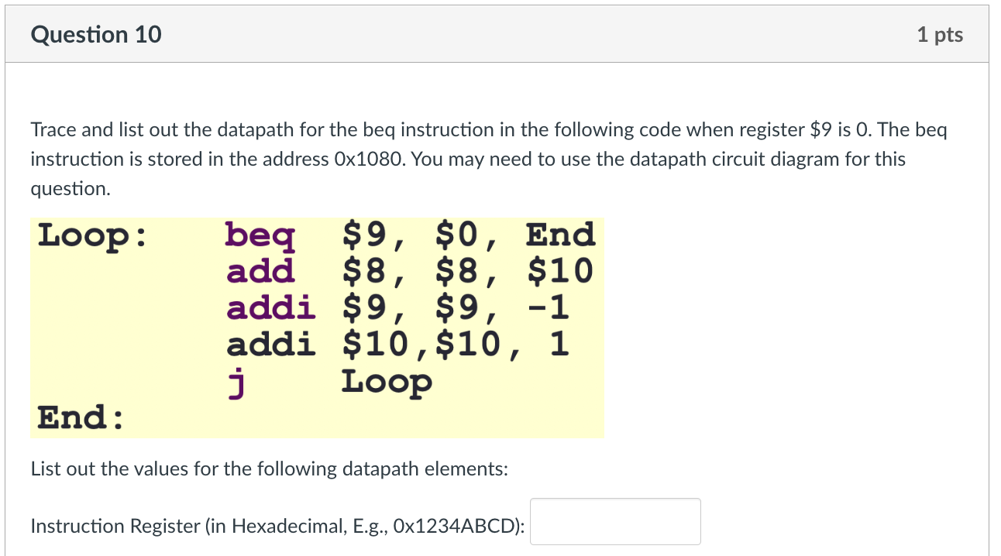
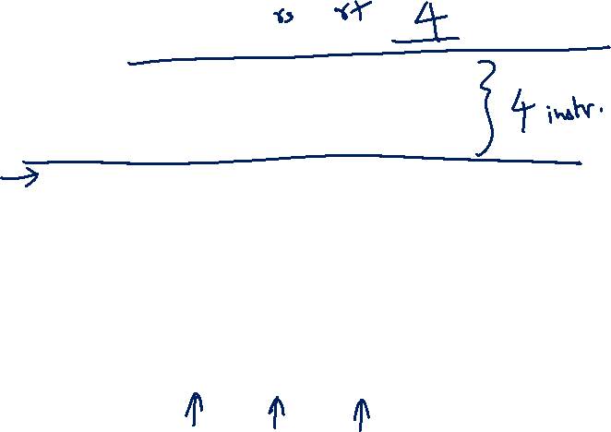
0x11200004
000100
01001
00000
0000 0000 0000 00100
op (6)
rs (5)
rt (5)
Immed (16)
0x11200004

Slide 52
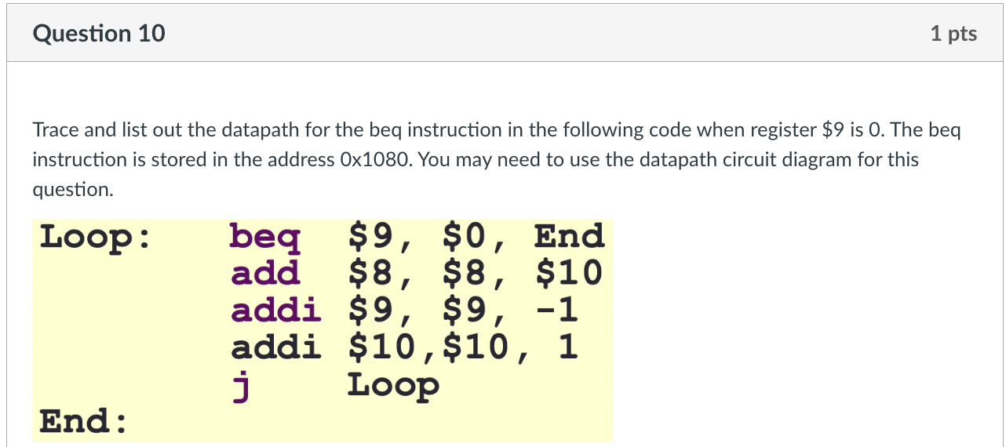
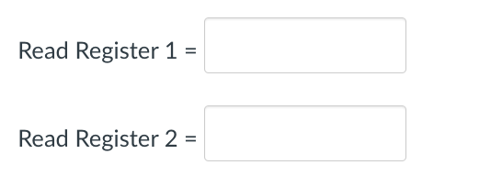
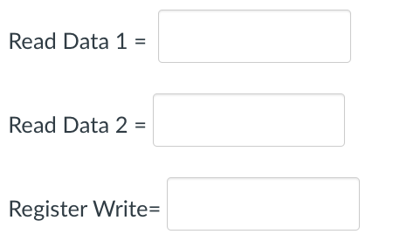
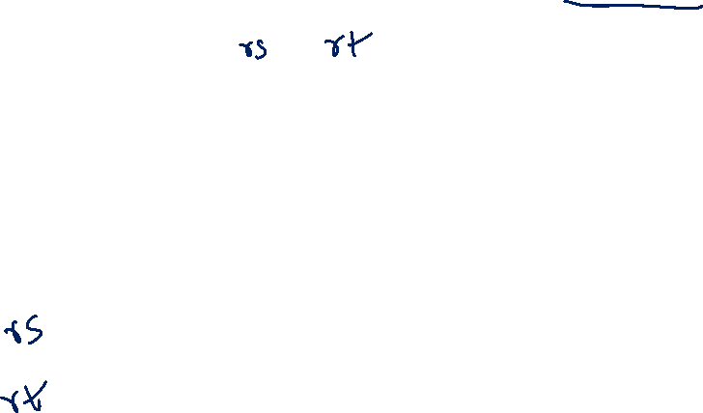
0
9
0
0
0

Slide 53
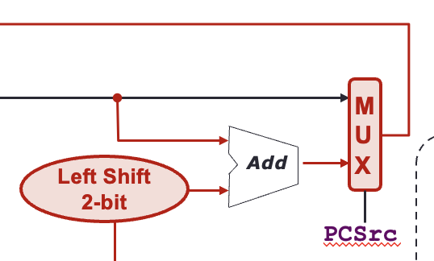
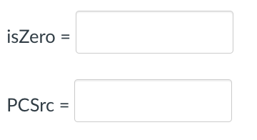
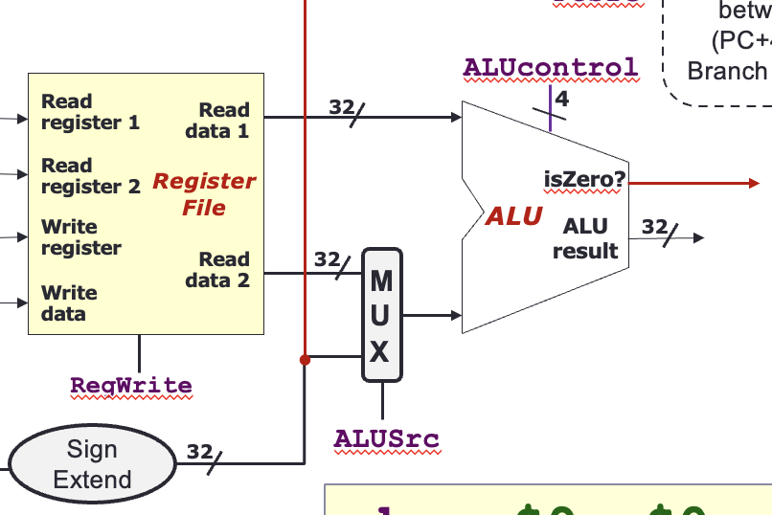
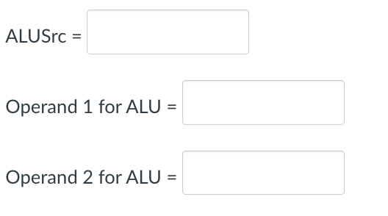

0
1
0
1
0

Slide 54



0x1080
0x1084
0x1088
0x108C
0x1090
0x1094
0
True
0

Slide 55
extra exercises

Slide 56


Question 1

Slide 57


Question 1a
General idea:
For blt, bit 31 (sign bit) of A op B will be 1 since (looking ahead) the branch compare operation is done with a subtraction, and A-B < 0 when A < B.
Can AND bit31 of A op B together with a “isBLT” output from the decoder that is “1” when we have a blt instruction (see later).
This then goes to an OR gate to OR with (isZero AND Branch) to create the new PCSrc signal to control PC.
ALUcontrol | Function
0000 | AND
0001 | OR
0010 | add
0110 | subtract
0111 | slt
1100 | NOR

Slide 58


Question 1b

Slide 59






Datapath & Control
Instruction
Memory
PC
Add
MUX
Instruction
4
Left Shift 2-bit
Add
Address
PCSrc
Control
Branch
Inst [31:26]
Inst [25:21]
5
RR1
RD1
Inst [20:16]
5
RR2
is0?
MemWrite
Registers
ALUSrc
ALU
opcode
31:26
rs
25:21
rt
20:16
rd
15:11
shamt
10:6
5
funct
5:0
WR
ALU
result
MUX
Address
RD2
MUX
WD
Data
Memory
MemToReg
Inst [15:11]
4
RegWrite
ALUcontrol
Read
Data
MUX
RegDst
Write
Data
Inst [15:0]
Sign Extend
Inst [5:0]
MemRead
ALUop
ALU Control

Slide 60

Designing the BLT Opcode Detector (isBLT)
Let’s choose an opcode for our new instruction. 0x2D is not taken, so let’s use that.
101101
rs
rt
Immediate
We use AND gates and NOT gates to implement the BLT signal.
General idea:
We want to generate a 1 whenever we have bit pattern 101101.
Let’s call the opcode bits Op5 to Op0 from left to right. Then we have: isBLT = Op5.Op4’.Op3.Op2.Op1’.Op0
This will produce a 1 for the opcode 101101

Slide 61


Question 2

Slide 62


Question 2
General idea:
Connect the shamt bits (bits 10 to 6 of the instruction) to the “shift amount” input of the shift register.
The “Direction” bit is connected to a NOT-AND decoder to decode the function bits (bits 0 to 5) of the instruction.
funct = 0x02 when it is srl
Output a “1” to right shift the register when funct = 0b000010
Change the MemToReg multiplexer to a 4:1 multiplexor instead of 2:1
Connect ALUResult to input 0 and ReadData to input 1 as usual. Connect output of shift register to input 2. Input 3 can be left for future expansion.
Select bits: 00 = ALUResult, 01 = ReadData, 10 = output of shift register.
Generate using mix of opcode and func bits – left as an exercise.

Slide 63


sll $8, $10, 2
ALUcontrol
Inst [25:21]
5
4
RR1
RD1
5
MemWrite
Inst [20:16]
RR2
Register
File
ALU
opcode
31:26
rs
25:21
rt
20:16
rd
15:11
shamt
10:6
5
000000
00000
01010
01000
funct
5:0
WR
ALU
result
00010
MUX
000000
Address
RD2
MUX
Data
Memory
WD
Inst [15:11]
RegWrite
Read
Data
MUX
RegDst
Write
Data
Inst [15:0]
16
Sign Extend
32
MemToReg

Slide 64

Mentimeter Quiz

Slide 65




Last week suggestion/feedback:

Slide 66

Q0 (just for fun)
If MIPS assembly controlled your daily life, which instruction would you use the most?
A) addi – I always need a little extra energy! ⚡
B) blt – If (sleep < 8 hours), go back to bed! 😴
C) j – Skip the boring parts and jump straight to fun! 🎉
D) lw – I keep loading new facts but forget to store them! 🤯
E) syscall – Calling for help every time life gets tricky! 📞

Slide 67
Q1
For a branch instruction (e.g., beq) in the MIPS datapath, what are the primary inputs fed into the ALU?
A) The sign-extended immediate field and the current PC
B) The two register values (rs and rt) to be compared
C) The result from Data Memory and a register value
D) The sign-extended immediate and a register value
E) None of the above

Slide 68
Q2
After receiving the two register values as inputs for a branch instruction (like beq), what operation does the ALU perform on these values, and how is the result used in the datapath?
A) It adds the two register values, and the sum is compared to the branch offset. B) It subtracts one register from the other; if the result is zero, the branch is taken. C) It performs a bitwise AND of the two register values, and the result is tested for a nonzero value. D) It shifts the register values left by 2 bits and then OR’s them, with the result forming the branch target. E) It computes the difference and then multiplies by the branch immediate to determine the new PC.

Slide 69

Q3
Consider the following MIPS instruction: lw $t0, -4($s0). Assume the following:
Register $s0 contains 0x10010004.
The 16‑bit immediate value is -4.
Memory at address 0x10010000 contains the 32‑bit word 0xABCD1234.
Options | Sign‑Extended Immediate | Effective Address | Loaded Value
A | 0xFFFFFFFC | 0x10010000 | 0xABCD1234
B | 0x000000FC | 0x10010000 | 0xABCD1234
C | 0xFFFFFFFC | 0x10010008 | 0xABCD1234
D | 0xFFFFFFFC | 0x10010000 | 0x00001234
E | None of the above

Slide 70

Q4
Refer to the MIPS datapath diagram provided. Suppose the instruction being executed is: sw $t0, 8($t1)
Which of the following datapath signals must be enabled (set to 1) for correct execution?
A) RegWrite, MemRead, PCSrc B) RegWrite, MemWrite, MemToReg C) ALUSrc, MemWrite D) MemRead, MemToReg, RegWrite E) RegWrite, ALUSrc, MemRead

Slide 71

Q5
Refer to the MIPS datapath diagram provided. Suppose the instruction being executed is: beq $t0, $t1, target. Assume the following:
$t0 = 5 and $t1 = 5
The 16-bit immediate offset for the target is 4.
Which of the following correctly describes the control signal PCSrc and the new PC value after executing this instruction?
Option | PCSrc Value | New PC Value
A | 0 | PC + 4
B | 1 | PC+4 + (4 × 4)
C | 1 | PC + 8
D | 1 | PC+4 + (4 + 4)
E | 1 | PC + (4 × 2)

Slide 72
End of File

